Slide 1
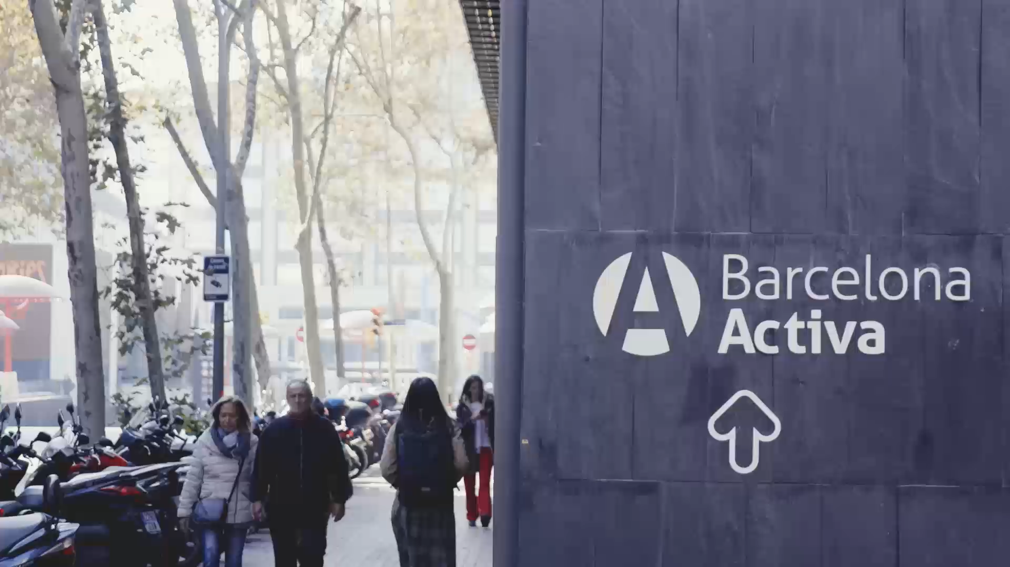

Barcelona
Activa
The economic development agency of Barcelona City Council

Slide 2

Ciclo de vida del talento
Lifelong Career Guidance
Lifelong Learning
Attraction and return
Creation
Barcelona International Welcome Desk
Return with opportunities
123 youths (2022)
STEAM Barcelona
Posa Talent Programme
Professional Life Project +12.000 students / year
Development
Reskilling programme
1.557 participants (2022)
Digital literacy and training
Digital programme: 16.022 participants (2022)
Advanced training: 1.193 participants (2022)
Soft Skills School
1.625 participants (2023)

Slide 3
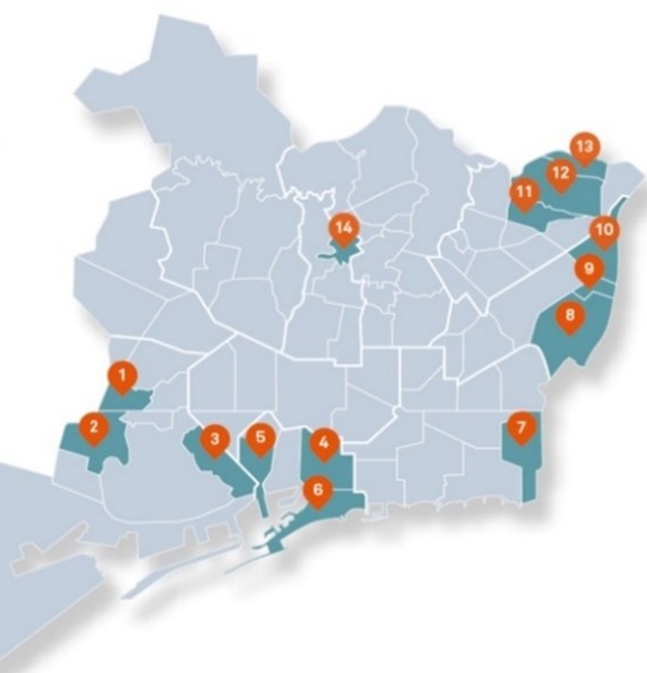


Labour Insertion Devices in Priority Action Neighbourhoods
Localized career guidance service
Counselling
Training
Labour intermediation
Territorial networking
Return on investment$=\frac{Monetized returns}{Required investment}$
Return on investment$=\frac{\text{4.828.527,10 }€}{\text{1.445.409,73} €}$ = 3,34

